Slide 1

Introduction to Python Programming
Exception handling
Ms. Shital H. Dinde

Slide 2
Exception
An exception is an unexpected event that occurs during program execution.
Errors that occur at runtime (after passing the syntax test) are called exceptions or logical errors.
For instance, they occur when we
try to open a file(for reading) that does not exist (FileNotFoundError)
try to divide a number by zero (ZeroDivisionError)
try to import a module that does not exist (ImportError) and so on.

Slide 3
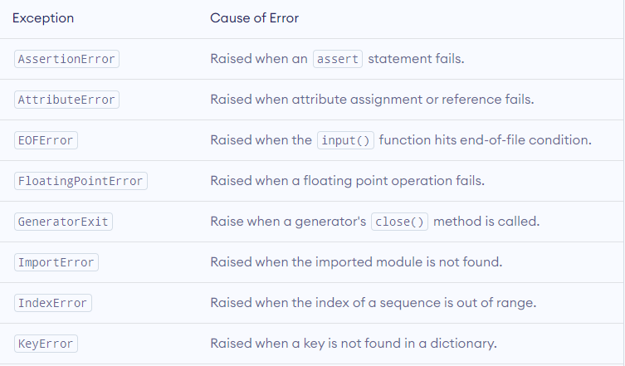
Built in Exception

Slide 4
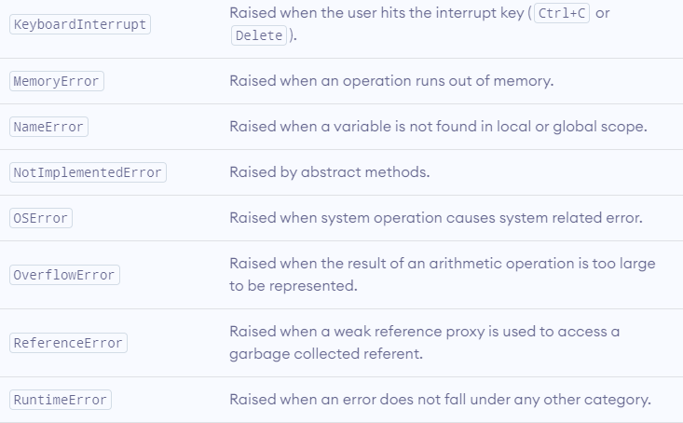

Slide 5
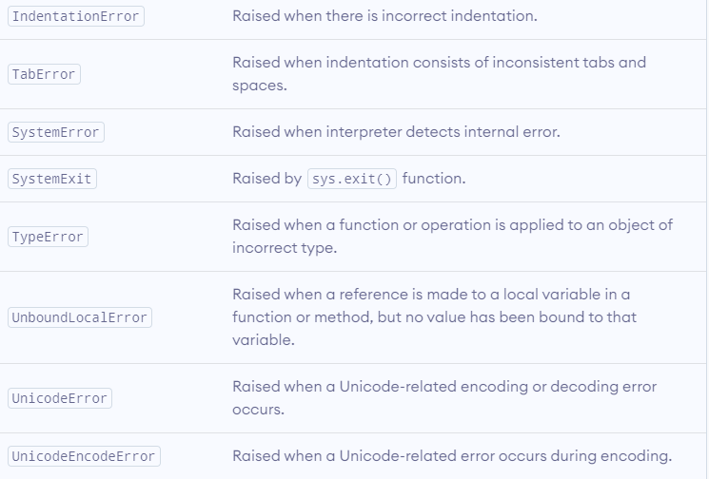

Slide 6
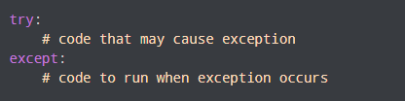
Exception
Python try...except Block

Slide 7
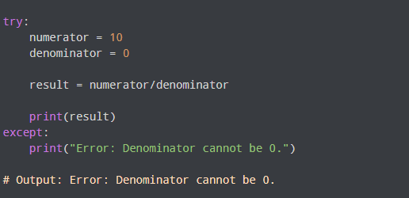

Slide 8
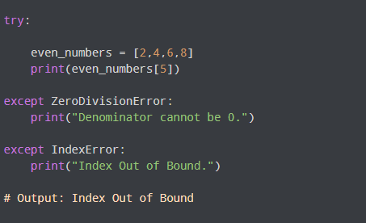
Catching Specific Exceptions in Python

Slide 9
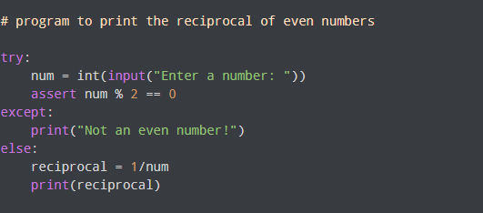
try with else clause

Slide 10
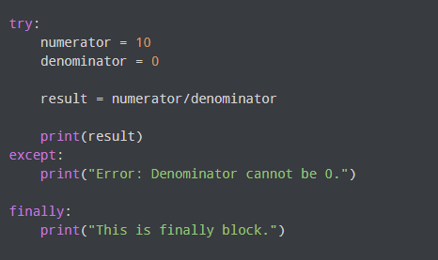
try...finally

Slide 11
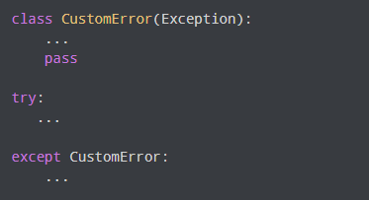
User Defined Exception

Slide 12
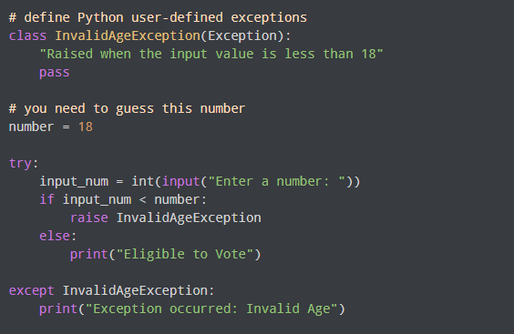

Slide 13
Create a user defined exception where the program will ask the user to input a number again and again until the user enters the correct stored number
Raise NegativeValueError exception if entered number is < 0
Raise ValueTooSmallError exception if entered number is < stored number
Raise ValueTooLargeError exception if entered number is > stored number
else print the message Correct value entered

Slide 14


Questions?

Slide 15

8888 763 563
88 5335 4141
https://svlautomations.in
https://svltrainings.in

